Slide 1
Convergence node
Sensor node
Central node
Report data
Forward data

Slide 2
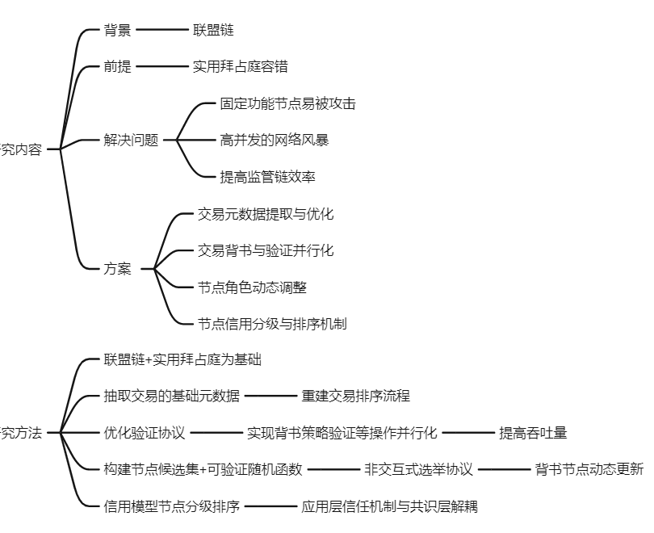
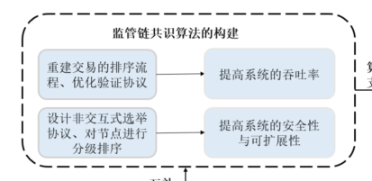
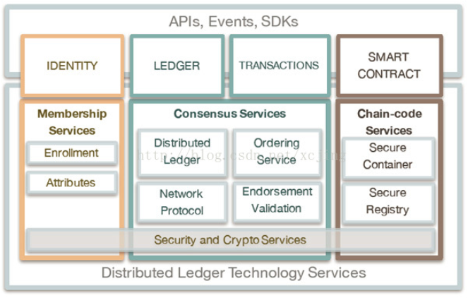

Slide 3
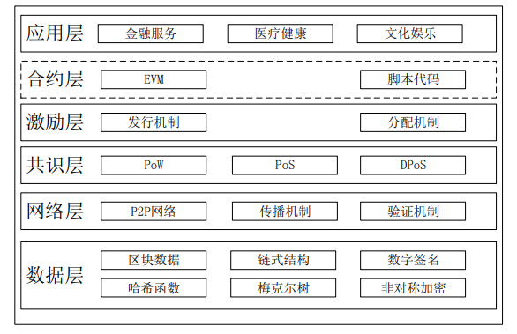

Slide 4
应用层
模块化
可插拔
低耦合
逻辑解耦
共识层
优化验证流程
评价指标体系
事务数据缓存
优化元数据
信用节点评价
节点动态更新
背书验证并行
重构事务排序
非交互式选举
信用节点分类
网络层
P2P
扁平拓扑
网络分层
扩容演进
基础区块结构
密码学技术
数据层
扩展数据结构
区块结构

Slide 5
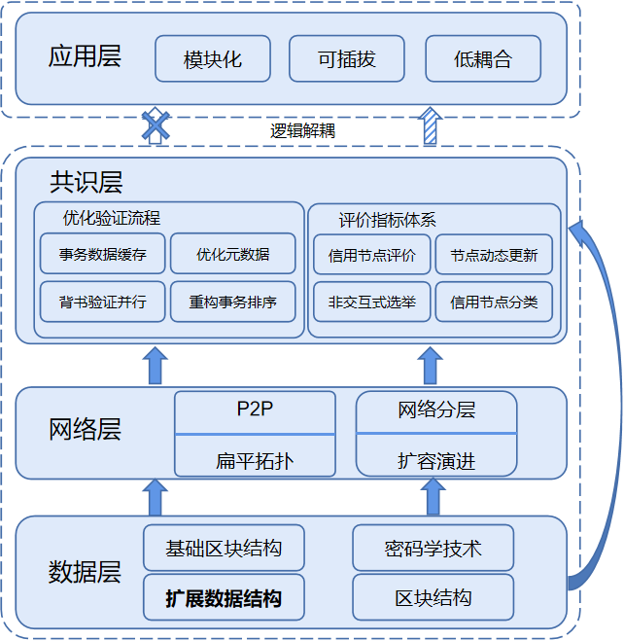
应用层
模块化
可插拔
低耦合
逻辑解耦
共识层
优化验证流程
评价指标体系
事务数据缓存
优化元数据
信用节点评价
节点动态更新
背书验证并行
重构事务排序
非交互式选举
信用节点分类
网络层
P2P
扁平拓扑
网络分层
扩容演进
基础区块结构
密码学技术
数据层
扩展数据结构
区块结构

Slide 6
Network Performance
Node Indicators
Report
Periodically
Throughput
Data Valid
Intermediary
Query
Aperiodically
Average Delay
Work Efficiency
Client
Stability
Computational power
Authority
Online duration
Report data
Blocklist
Connectivity
Forward data
Allowlist
Processing Delay

Slide 7
Virtuous
Authority
Authority
Client
Intermediary
New
Malicious
Clinet
Intermediary

Slide 8
偏移
前区块头哈希
区块头
前区块哈希
区块体
区块元数据

Slide 9
Block Header
Block Body
Block Metadata
Contract Info
Operation.1
Block Info
Block Number
Operation.2
Transaction Info
Block Hash
Operation.3
Previous Block Hash
Control Info
Authorization Info
Base Info
Signature
Auditing Info
Sys.Node Info
Configuration
Extensive Info
Trans Flag

Slide 10
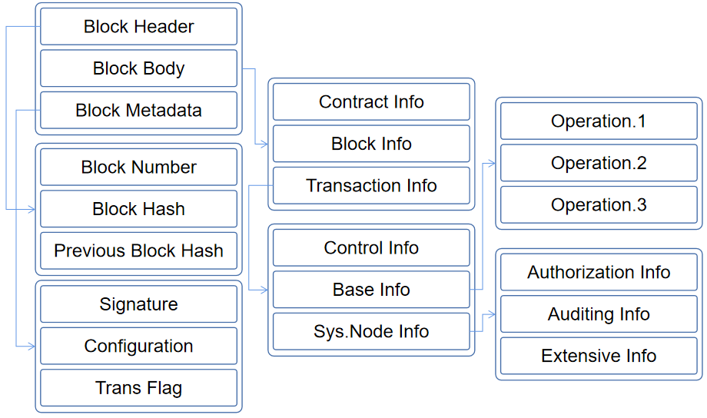
初始链块
A子链区块
过渡区块
B子链区块
C子链区块
控制块
叔区块哈希索引
父区块哈希索引
data volume
operation.1
block size
blockheader
data index
operation.2
blockheader
Trans.Info
extended info
operation.3
block body
Trans.Data
operation.3
version
blockheader
data volume
previous hash
blockheader
transition data
previous hash
data index
merkel root
audit hash
extended info
time stamp
Trans.Data
target difficult
blockheader
data type
nonce
base info
Authorization Info
control data
extended data
Auditing Info
Signature
control data
Configuration
Trans.Flag

Slide 11
data volume
operation.1
block size
blockheader
data index
operation.2
blockheader
Trans.Info
extended info
operation.3
block body
Trans.Data
operation.3
version
blockheader
blockheader
data volume
previous hash
transition data
previous hash
data index
merkel root
audit hash
extended info
time stamp
Trans.Data
target difficult
blockheader
data type
nonce
base info
Authorization Info
Signature
control data
extended data
Auditing Info
Configuration
control data
Trans.Flag

Slide 12
传感数据区块
A子链区块
过渡区块
B子链区块
C子链区块
控制数据区块
叔区块哈希索引
父区块哈希索引
blockheader
blockheader
blockheader
blockheader
blockheader
blockheader
blockheader
list of sensing data
previous hash
previous hash
previous hash
previous hash
previous hash
previous hash
list of sensing data
list of sensing data
list of sensing data
list of sensing data
subchain audit info
subchain audit info
initial blcok
subchain audit info
subchain audit info
blockheader
blockheader
blockheader
blockheader
blockheader
previous hash
previous hash
previous hash
previous hash
previous hash
list of sensing data
list of sensing data
list of sensing data
list of sensing data
list of sensing data

Slide 13








网络层
共识层
感知层

Slide 14
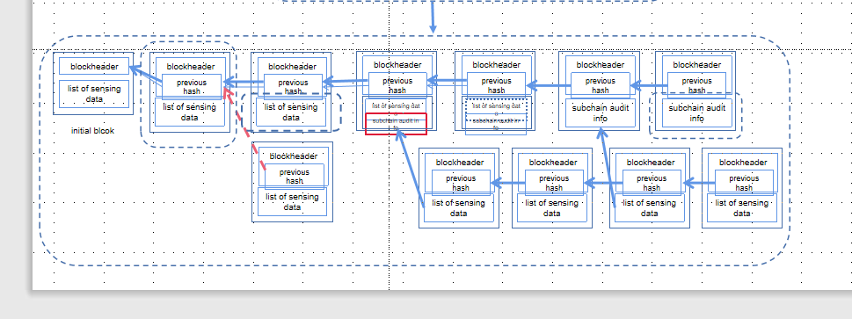
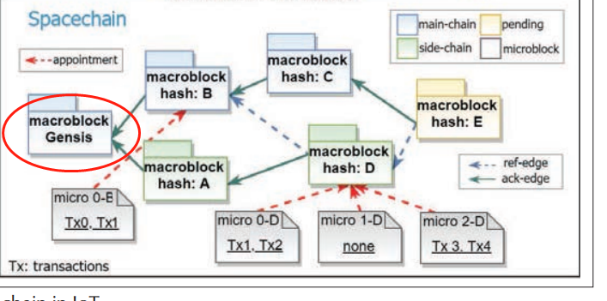

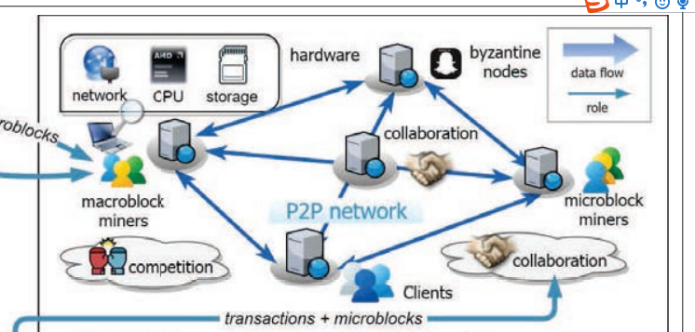










体现出：（1）新增节点（2）三级节点（3）可信和恶意节点（4）分布式（5）侧链节点

Slide 15



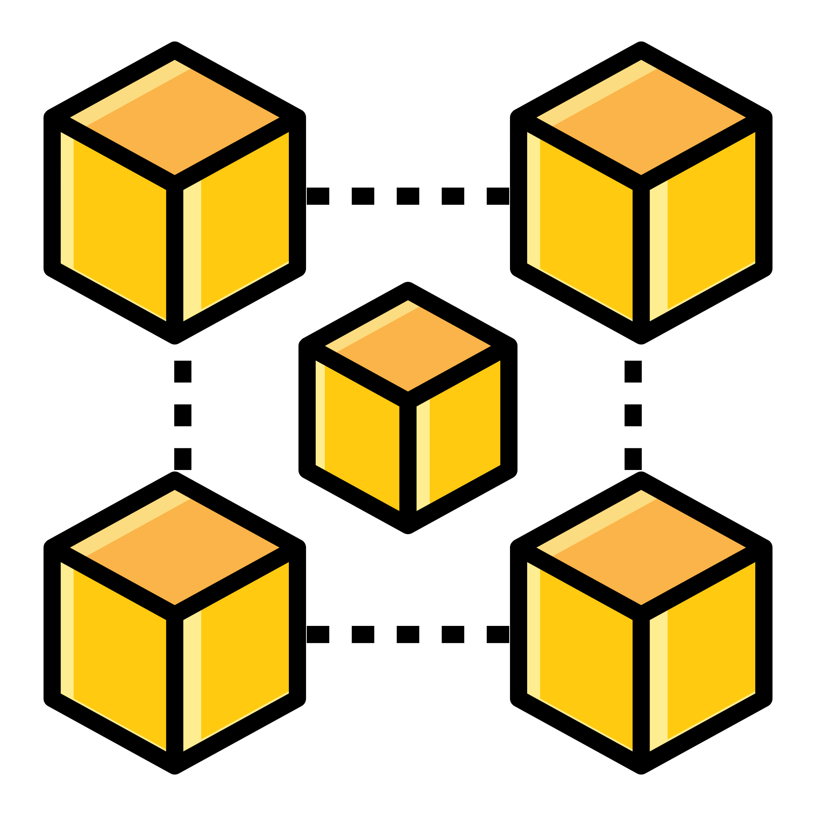
Extended Monitoring
Storage
Service
Crowdsourcing
monitoring
Transmission
Network Layer
Monitoring
Indicators
Report
Broadcast
Weather
Fire
Noise pollution
Geological
Hazards
Air quality
Video Surveillance
Redundant block
Data block
Transition Block
Control block
Control block
Initial block
Data block
UAV
RS
physical sensors
Data block
Data block
Redundant block
Redundant block
Data block
Data block
Multiple monitoring scenarios
Sensing Layer
Consensus Layer
体现出：（1）新增节点（2）三级节点（3）可信和恶意节点（4）分布式（5）侧链节点

Slide 17
传感数据区块
A子链区块
传感数据和控制数据区块
B子链区块
C子链区块
控制数据区块
叔区块哈希索引
父区块哈希索引
blockheader
blockheader
blockheader
blockheader
blockheader
blockheader
blockheader
list of sensing data
previous hash
previous hash
previous hash
previous hash
previous hash
previous hash
list of sensing data
list of sensing data
list of sensing data
list of sensing data
subchain audit info
subchain audit info
initial blcok
subchain audit info
subchain audit info
blockheader
blockheader
blockheader
blockheader
blockheader
previous hash
previous hash
previous hash
previous hash
previous hash
list of sensing data
list of sensing data
list of sensing data
list of sensing data
list of sensing data

Slide 18
传感数据区块
A子链区块
传感数据和控制数据区块
B子链区块
C子链区块
控制数据区块
叔区块哈希索引
父区块哈希索引

Slide 19
Virtuous
Authority
Authority
Client
Intermediary
New
Malicious
Clinet
Intermediary

Slide 20
3.科研经历
基于区块链的可信传感网构建方法
传感数据区块
A子链区块
传感数据和控制数据区块
Virtuous
Miner
Miner
B子链区块
C子链区块
New
Sensor
Broadcaster
控制数据区块
Malicious
Sensor
Broadcaster
叔区块哈希索引
父区块哈希索引

Slide 21
Network Performance
Node Indicators
Throughput
Data Valid
Convergence node
Average Delay
Work Efficiency
Sensor node
Stability
Computational power
Central node
Online duration
Report data
Blocklist
Connectivity
Forward data
Allowlist
Processing Delay

Slide 22
Node Indicators
Data Valid
Work Efficiency
Computational power
Online duration
Network Performance
Connectivity
Throughput
Processing Delay
Average Delay
Stability
Convergence node
Sensor node
Blocklist
Central node
Allowlist
Report data
Forward data

Slide 23
传感数据区块
A子链区块
传感数据和控制数据区块
B子链区块
C子链区块
控制数据区块
叔区块哈希索引
父区块哈希索引

Slide 24
blockheader
blockheader
blockheader
blockheader
blockheader
blockheader
blockheader
list of sensing data
previous hash
previous hash
previous hash
previous hash
previous hash
previous hash
list of sensing data
list of sensing data
list of sensing data
list of sensing data
subchain audit info
subchain audit info
initial blcok
subchain audit info
subchain audit info
blockheader
blockheader
blockheader
blockheader
blockheader
previous hash
previous hash
previous hash
previous hash
previous hash
list of sensing data
list of sensing data
list of sensing data
list of sensing data
list of sensing data

Slide 25
传感数据区块
A子链区块
传感数据和控制数据区块
B子链区块
C子链区块
控制数据区块
叔区块哈希索引
父区块哈希索引

Slide 28
传感数据区块
A子链区块
传感数据和控制数据区块
B子链区块
C子链区块
控制数据区块
叔区块哈希索引
父区块哈希索引
blockheader
blockheader
blockheader
blockheader
blockheader
blockheader
blockheader
list of sensing data
previous hash
previous hash
previous hash
previous hash
previous hash
previous hash
list of sensing data
list of sensing data
list of sensing data
list of sensing data
subchain audit info
subchain audit info
initial blcok
subchain audit info
subchain audit info
blockheader
blockheader
blockheader
blockheader
blockheader
previous hash
previous hash
previous hash
previous hash
previous hash
list of sensing data
list of sensing data
list of sensing data
list of sensing data
list of sensing data

Slide 30





Slide 31
Convergence node
Sensor node
Central node
Report data
Forward data

Slide 32
blockheader
blockheader
blockheader
blockheader
blockheader
blockheader
blockheader
list of sensing data
previous hash
previous hash
previous hash
previous hash
previous hash
previous hash
list of sensing data
list of sensing data
list of sensing data
list of sensing data
subchain audit info
subchain audit info
initial blcok
subchain audit info
subchain audit info
blockheader
blockheader
blockheader
blockheader
previous hash
previous hash
previous hash
previous hash
list of sensing data
list of sensing data
list of sensing data
list of sensing data

